Slide 1
Association Rules
Notes:
<νυμβερ>

Slide 2
Learning Outcomes
Understand the concept of association rules
Define and use support and confidence measures
Introduce the Apriori algorithm
Notes:
<νυμβερ>

Slide 3

What is Association Mining?
Association rule mining
  Find frequent patterns, associations, correlations, or causal structures among sets of items or objects in transaction databases, relational databases, and other information repositories
Applications
  Basket data analysis, cross-marketing, catalog design, loss-leader analysis, clustering, classification, etc.
Examples
  Rule form: “Body ➔ Head [support, confidence]”
  buys(x, “Pizza”) ➔buys(x, “beers”) [0.5%, 60%]
  major(x, “CS”) ^ takes(x,“DB”) ➔ grade(x,“A”)[1%, 75%]
Notes:
<νυμβερ>
# The rule X ==> Y holds with confidence c in transaction set D, if and only if c% of transactions in D that contain X also contain Y.
# The rule X ==> Y has support s in transaction set D, if and only if s% of transactions in D contain X U Y

Slide 4
Association Rule: Basic Concepts
Given: (1) a set of transactions, (2) each transaction is a list of items (purchased by a customer in a visit)
Find: all rules that correlate the presence of one set of items with that of another set of items
  E.g., 98% of people who purchase tires and auto accessories also get automotive services done
Applications
  Maintenance Agreement: (What the store should do to boost Maintenance Agreement sales)
  Home Electronics: (What other products should the store stocks up?)
  Attached mailing in direct marketing
Notes:
<νυμβερ>

Slide 5
Rule Measures: Support and Confidence
Customer
buys both
Find all the rules Y ➔ Z with minimum confidence and support
  support, s, probability that a transaction contains { Y ➔ Z }
  confidence, c, conditional probability that a transaction having Y also contains Z
Customer
buys pizza
Customer
buys beer
Let minimum support be 50%, and minimum confidence 50%, we have
  A ➔ C (50%, 66.6%)
  C ➔ A (50%, 100%)
Transaction ID | Items Bought
2000 | A,B,C
1000 | A,C
4000 | A,D
5000 | B,E,F
Notes:
<νυμβερ>
Α ==> Β (σ, φ)
Συππορτ, σ: ισ τηε περχενταγε οφ τρανσαχτιονσ ιν Δ (τοταλ νυμβερ οφ τρανσαχτιονσ) τηατ χονταιν Α Υ Β −−− (Π(Α Υ Β)
Χονφιδενχε, φ: ισ τηε περχενταγε οφ τρανσαχτιονσ ιν Δ χονταινινγ Α τηατ αλσο χονταιν Β. (Π(Β/Α)

Slide 6
AR Mining: A Road Map
Boolean vs. quantitative associations
  Based on the types of values handled)
  buys(x, “SQLServer”) ^ buys(x, “DMBook”) ➔ buys(x, “DBMiner”) [0.2%, 60%]
  age(x, “30..39”) ^ income(x, “42..48K”) ➔ buys(x, “PC”) [1%, 75%]
Single dimension vs. multiple dimensional associations
  See examples above
Single level vs. multiple-level analysis
  What brands of beers are associated with what brands of pizzas?
Various extensions
  Correlation, causality analysis
    Association does not necessarily imply correlation or causality
  Maxpatterns and closed itemsets
  Constraints enforced
    E.g., small sales (sum < 100) trigger big buys (sum > 1,000)?
Notes:
<νυμβερ>

Slide 7
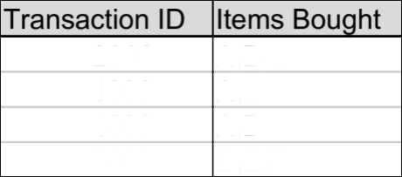
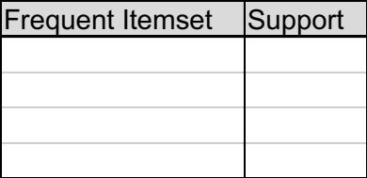
Mining Association Rules—An Example
Min. support 50%
Min. confidence 50%
For rule A ➔ C:
  support = support({A U C}) = 50%
  confidence = support({A U C})/support({A}) = 66.6%
The Apriori principle:
  Any subset of a frequent itemset must be frequent
Notes:
<νυμβερ>

Slide 8
Mining Frequent Itemsets: the Key Step
Find the frequent itemsets: the sets of items that have minimum support
  A subset of a frequent itemset must also be a frequent itemset
    i.e., if {AB} is a frequent itemset, both {A} and {B} should be frequent itemsets
  Iteratively find frequent itemsets with cardinality from 1 to k (k-itemset)
Use the frequent itemsets to generate association rules
Notes:
<νυμβερ>

Slide 9
The Apriori Algorithm
Join Step: C_{k} is generated by joining L_{k-1}with itself
Prune Step: Any (k-1)-itemset that is not frequent cannot be a subset of a frequent k-itemset
Pseudo-code:
    C_{k}: Candidate itemset of size k
    L_{k} : frequent itemset of size k
    L₁ = {frequent items};
    for (k = 1; L_{k} != {}; k++) do begin
    C_{k+1} = candidates generated from L_{k};
    for each transaction t in database do
      increment the count of all candidates in C_{k+1} that are contained in t
    L_{k+1} = candidates in C_{k+1} with min_support
    end
    return L = U_{k} L_{k};
Notes:
<νυμβερ>

Slide 10
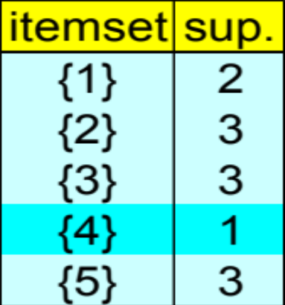
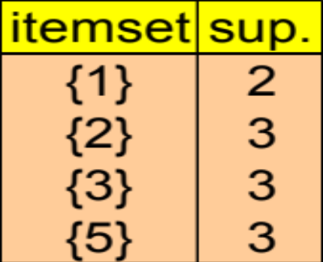
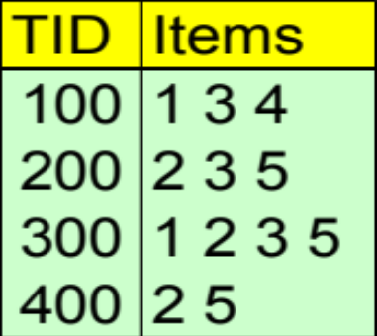
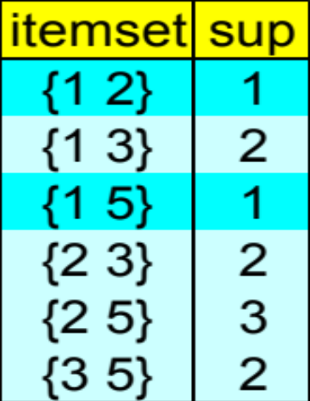
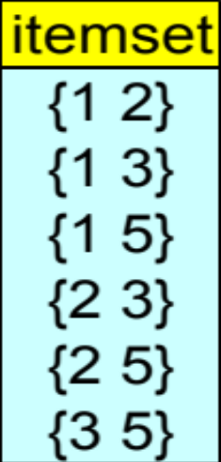
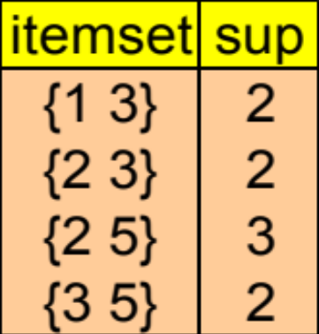
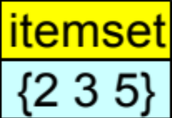
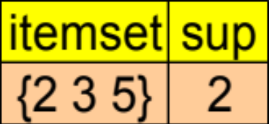
The Apriori Algorithm — Example
Database D
L₁
C₁
Scan D
C₂
C₂
L₂
Scan D
C₃
Scan D
L₃
Notes:
<νυμβερ>

Slide 11
How to Generate Candidates?
Suppose the items in L_{k-1} are listed in an order
Step 1: self-joining L_{k-1}
  insert into C_{k}
  select p.item₁, p.item₂, …, p.item_{k-1}, q.item_{k-1}
  from L_{k-1} p, L_{k-1} q
  where p.item₁=q.item₁, …, p.item_{k-2}=q.item_{k-2}, p.item_{k-1} < q.item_{k-1}
Step 2: pruning
  forall itemsets c in C_{k} do
    forall (k-1)-subsets s of c do
      if (s is not in L_{k-1}) then delete c from C_{k}
Notes:
<νυμβερ>

Slide 12
How to Count Supports of Candidates?
Why counting supports of candidates a problem?
  The total number of candidates can be very huge
  One transaction may contain many candidates
Method
  Candidate itemsets are stored in a hash-tree
  Leaf node of hash-tree contains a list of itemsets and counts
  Interior node contains a hash table
  Subset function: finds all the candidates contained in a transaction
Notes:
<νυμβερ>

Slide 13
Example of Generating Candidates
L₃={abc, abd, acd, ace, bcd}
Self-joining: L₃*L₃
  abcd from abc and abd
  acde from acd and ace
Pruning:
  acde is removed because ade is not in L₃
C₄={abcd}
Notes:
<νυμβερ>

Slide 14
Performance Bottlenecks: Is Apriori Fast Enough?
The core of the Apriori algorithm
  Use frequent (k – 1)-itemsets to generate candidate frequent k-itemsets
  Use database scan and pattern matching to collect counts for the candidate itemsets
The bottleneck of Apriori: candidate generation
  Huge candidate sets:
    10⁴ frequent 1-itemset will generate 10⁷ candidate 2-itemsets
    To discover a frequent pattern of size 100, {a₁, a₂, …, a₁₀₀}, one needs to generate 2¹⁰⁰ (about 10³⁰ ) candidates
  Multiple scans of database:
    Needs (n +1 ) scans, n is the length of the longest pattern
Notes:
<νυμβερ>

Slide 15
Methods to Improve Apriori’s Efficiency
Hash-based itemset counting: A k-itemset whose corresponding hashing bucket count is below the threshold cannot be frequent
Transaction reduction: A transaction that does not contain any frequent k-itemset is useless in subsequent scans
Partitioning: Any itemset that is potentially frequent in DB must be frequent in at least one of the partitions of DB
Sampling: mining on a subset of given data, lower support threshold + a method to determine the completeness
Dynamic itemset counting: add new candidate itemsets only when all of their subsets are estimated to be frequent
Notes:
<νυμβερ>

Slide 16
Mining FPs Without Candidate Generation
Compress a large database into a compact, Frequent-Pattern tree (FP-tree) structure
  highly condensed, but complete for frequent pattern mining
  avoid costly database scans
Develop an efficient, FP-tree-based frequent pattern mining method
  A divide-and-conquer methodology: decompose mining tasks into smaller ones
  Avoid candidate generation: sub-database test only!
Notes:
<νυμβερ>

Slide 17
Construct FP-tree from a Transaction DB
min_support = 3
TID Items bought (ordered) frequent items
100 {f, a, c, d, g, i, m, p} {f, c, a, m, p}
200 {a, b, c, f, l, m, o} {f, c, a, b, m}
300 {b, f, h, j, o} {f, b}
400 {b, c, k, s, p} {c, b, p}
500 {a, f, c, e, l, p, m, n} {f, c, a, m, p}
{}
Steps:
Scan DB once, find frequent 1-itemset (single item pattern)
Order frequent items in frequency descending order
Scan DB again, construct FP-tree
Header Table
Item frequency head
f 4
c 4
a 3
b 3
m 3
p 3
f:4
c:1
c:3
b:1
b:1
a:3
p:1
m:2
b:1
p:2
m:1
Notes:
<νυμβερ>

Slide 18
Benefits of the FP-tree Structure
Completeness
  never breaks a long pattern of any transaction
  preserves complete information for frequent pattern mining
Compactness
  reduce irrelevant information—infrequent items are gone
  frequency descending ordering: more frequent items are more likely to be shared
  never be larger than the original database (if not count node-links and counts)
Notes:
<νυμβερ>

